Slide 1
ESCAPE EQUATION
THE MATH BREAKOUT
AYON ARYAN 1RVU23CSE093 ,HARDIK GOEL 1RVU23CSE180,SRISTI LOSALKA 1RVU23CSE472,LAVANYA MEHRISH 1RVU23CSE234

Slide 2
Overview
Welcome to the presentation on our Escape Equation , developed using Python and Flask. This game aims to improve quick math skills by challenging players with random math questions under a time constraint. Players must solve as many problems as possible within 30 seconds, covering addition, subtraction, multiplication, and division. The game tracks scores and displays a leaderboard for competitive play. In this presentation, we will explore the game's features, technical implementation, user interface, and potential future enhancements. Join us as we discuss the development process and how this game can make learning math engaging and fast-paced.

Slide 3
Why We Made IT?
The aim of creating the Escape Equation is to develop an interactive and engaging tool that helps users enhance their mathematical skills through quick problem-solving under time pressure. By leveraging Python and Flask for the backend, and integrating a leaderboard system, the game not only provides an educational experience but also fosters a competitive environment that motivates users to improve their performance. The project combines software development with educational objectives, aiming to deliver a fun and effective learning platform.

Slide 4
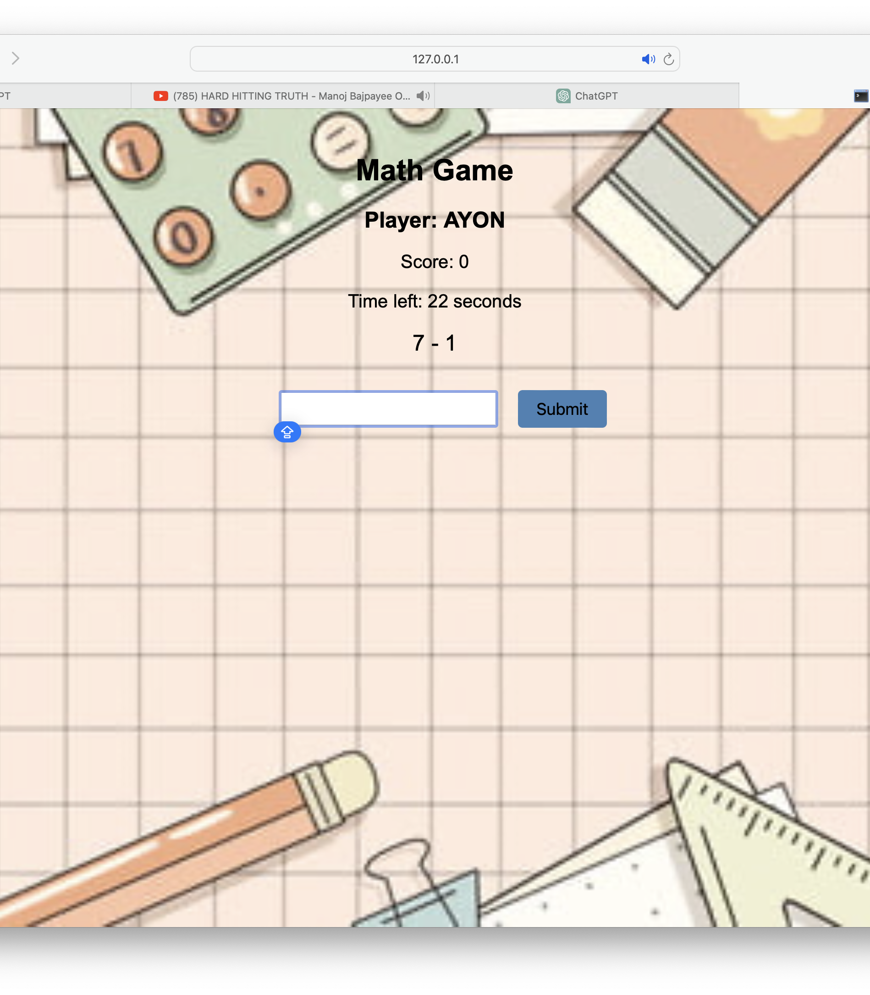
User Interface
UI AND UX
Our aim was to design a user interface (UI) and user experience (UX) that is intuitive and accessible for both kids and adults. The interface is simple and clean, ensuring that users can easily navigate and focus on the game. We incorporated an inbuilt leaderboard to track and display scores, fostering a sense of friendly competition among friends and family. This design approach ensures that the game is not only engaging and fun but also user-friendly, encouraging repeated play and continuous improvement in math skills.

Slide 5
FEATURES
Random Math Questions: The game generates random questions covering addition, subtraction, multiplication, and division, providing a diverse range of problems to solve.
Timed Gameplay: Each game session is limited to 30 seconds, challenging players to solve as many questions as possible within the time frame.
Score Tracking: Players' scores are tracked in real-time, rewarding correct answers and deducting points for incorrect ones, adding an element of challenge and excitement.
Inbuilt Leaderboard: The game includes a leaderboard that records and displays the top scores, allowing players to compete with friends and family and strive for improvement.
Simple UI/UX: The user interface is designed to be straightforward and easy to use, making it accessible for both kids and adults. Clear visuals and minimalistic design ensure that users can focus on the game itself.
Session Management: The game maintains session data, such as player name and score, ensuring a seamless experience throughout the gameplay.
Database Integration: Scores and player information are stored in an SQLite database, enabling persistent tracking and retrieval of high scores.

Slide 6
CONCLUTION
In conclusion, the Escape Equation represents an innovative approach to enhancing math skills through interactive gameplay. By prioritising simplicity and accessibility in UI/UX design, the game ensures that users of all ages can enjoy and benefit from the experience. The incorporation of features such as random math questions, timed gameplay, score tracking, and an inbuilt leaderboard adds excitement and motivation for players to engage in continuous learning and improvement. With its seamless session management and database integration, the game offers a personalized and rewarding experience for users, fostering a sense of achievement and friendly competition. Overall, the Rapid-Fire Maths Game serves as an effective tool for making math education engaging, fun, and accessible to a wide audience.

